Slide 1

Data Analysis – Campaign
Sunita Murugan

Slide 2
Expansion
Treadmill Maximal Exercise.
Business should be always focused with the customer requirement. Demand and supply factor.
Along with this , out standing in the market is also important. Utilizing the missing part will provide
More opportunity to growth. A study with 992 graded test with the age group 10-63 yrs. This insight offers a valuable insights into Exercise physiology and human performance with potential applications in sports science, medicine and research
Objective:
Objective of data set analysis is to find the scope of this business, which means the better understanding of the data and to find the missing factor. Business focus can be made towards those fields.
In this we tried to achieve a high-level direction for Business Campaign.

Slide 3
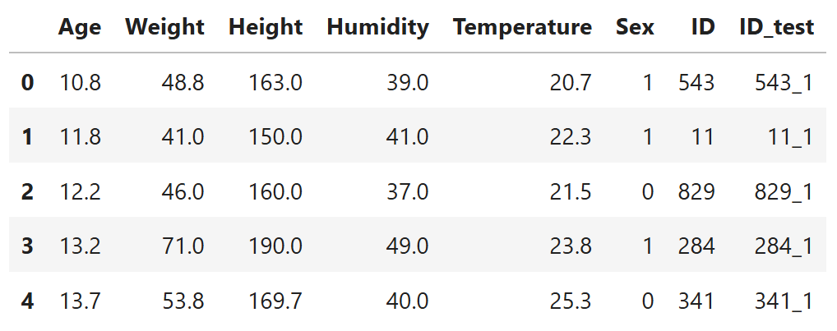
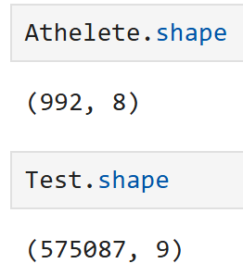
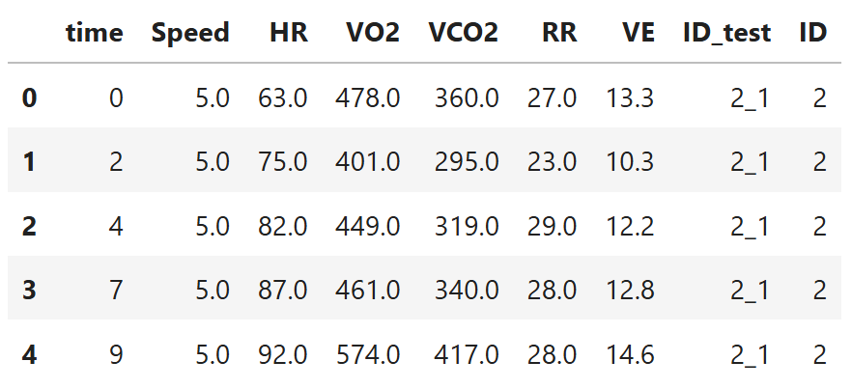
Expansion
This display the view of the first five rows of both tables. Shape defines the number of rows and column in table

Slide 4
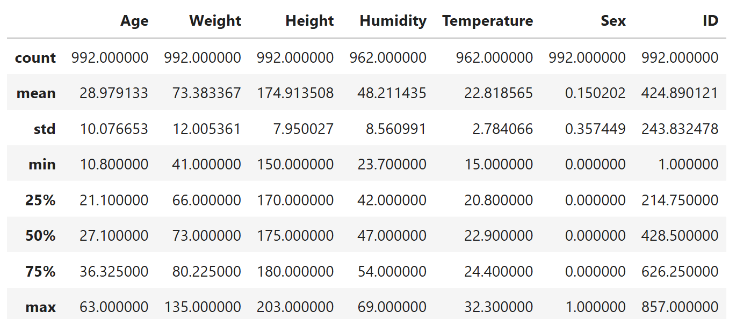
Expansion
The table displays the count , mean, std and the min of the value of the dataset from the Athlete table

Slide 5
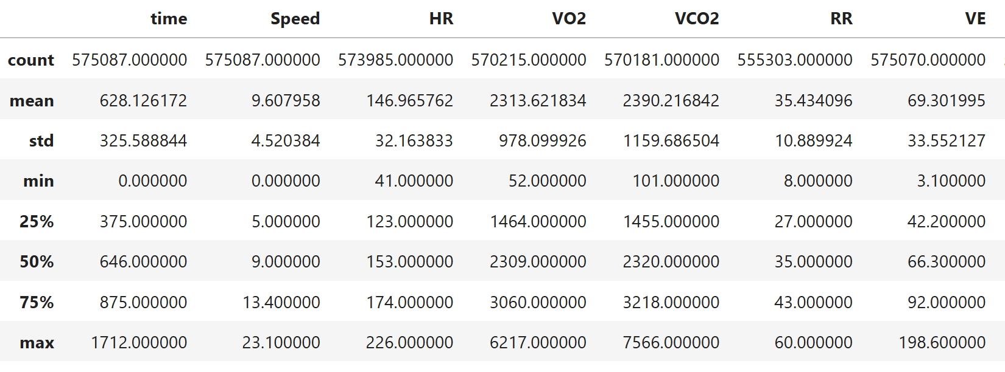
Expansion
The table displays the count , mean, std and the min of the value of the dataset from the Test table

Slide 6
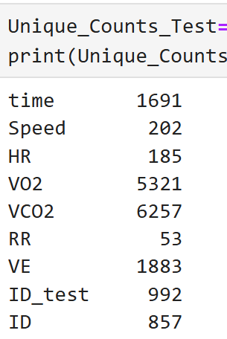
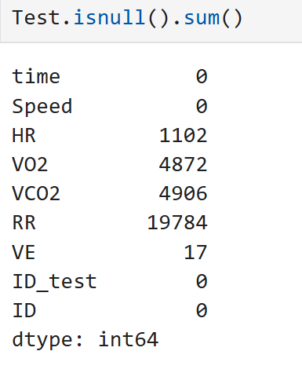
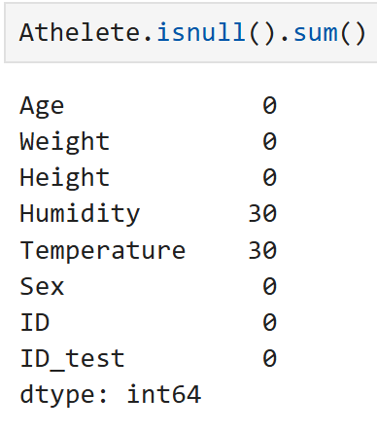
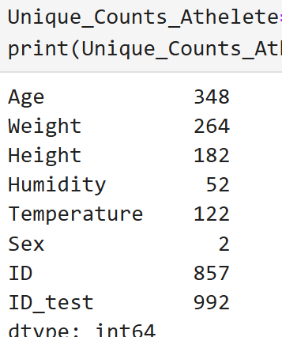
Expansion
This table showcase if there
is any duplicate values
in the table
This shows the unique
count of the value from
Test table
This shows the unique
count of the value from
Athelete table
This table showcase if there
is any duplicate values
in the table

Slide 7
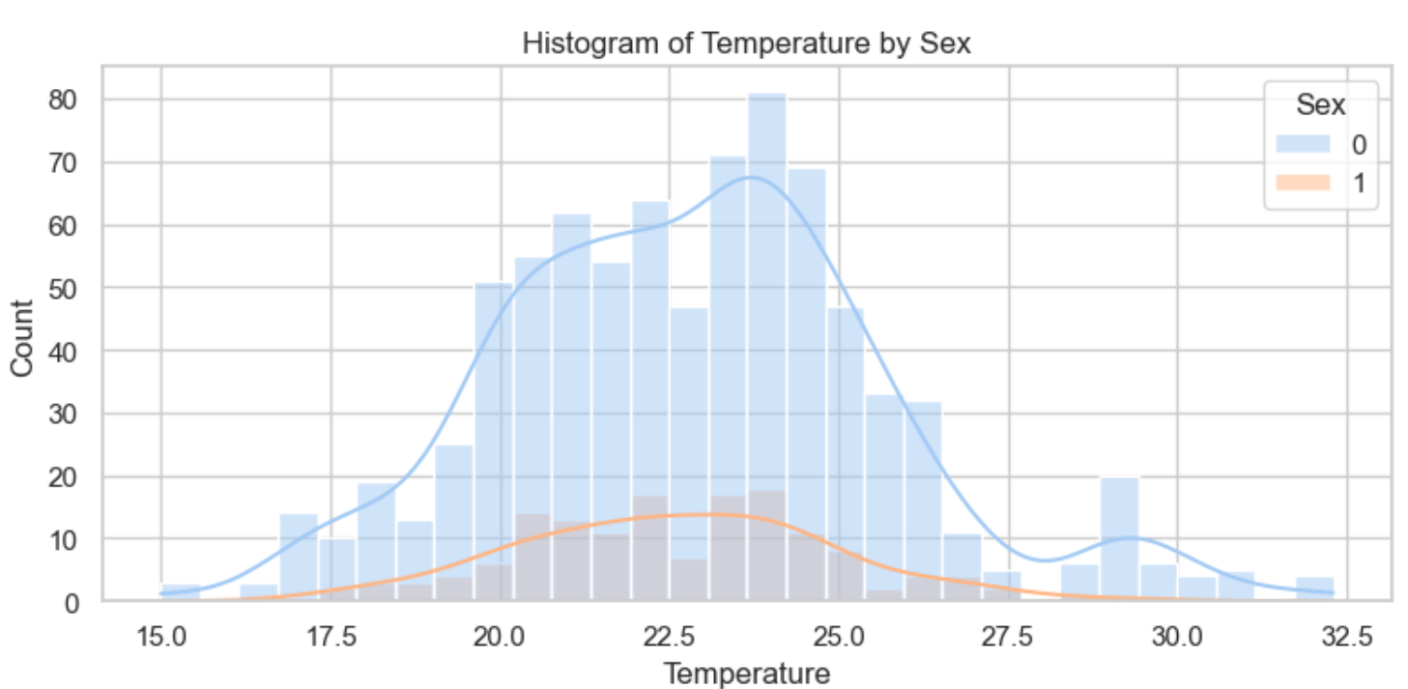
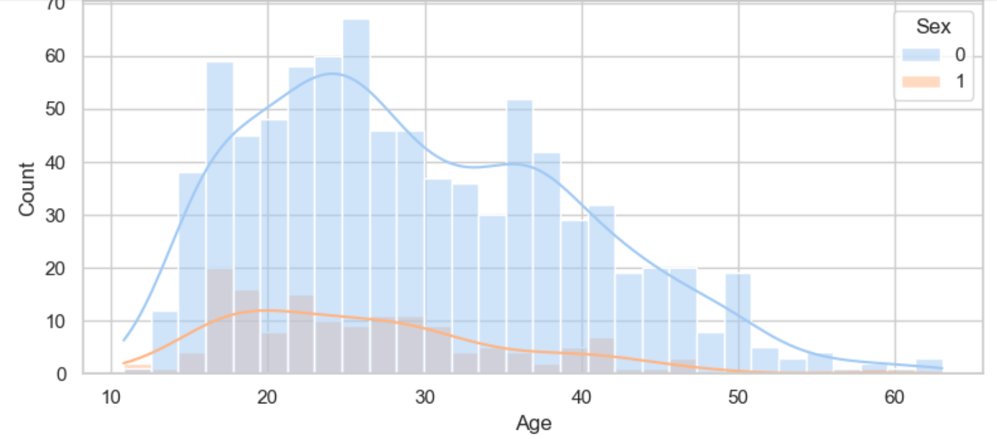
Expansion
From the above graph, it is clear that the value for the female is less for age and temperature in
comparison to the male

Slide 8
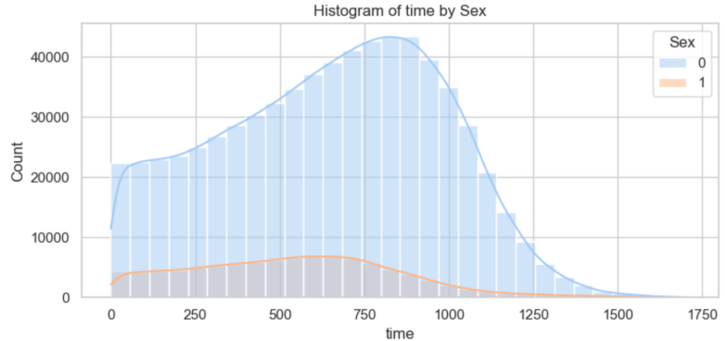
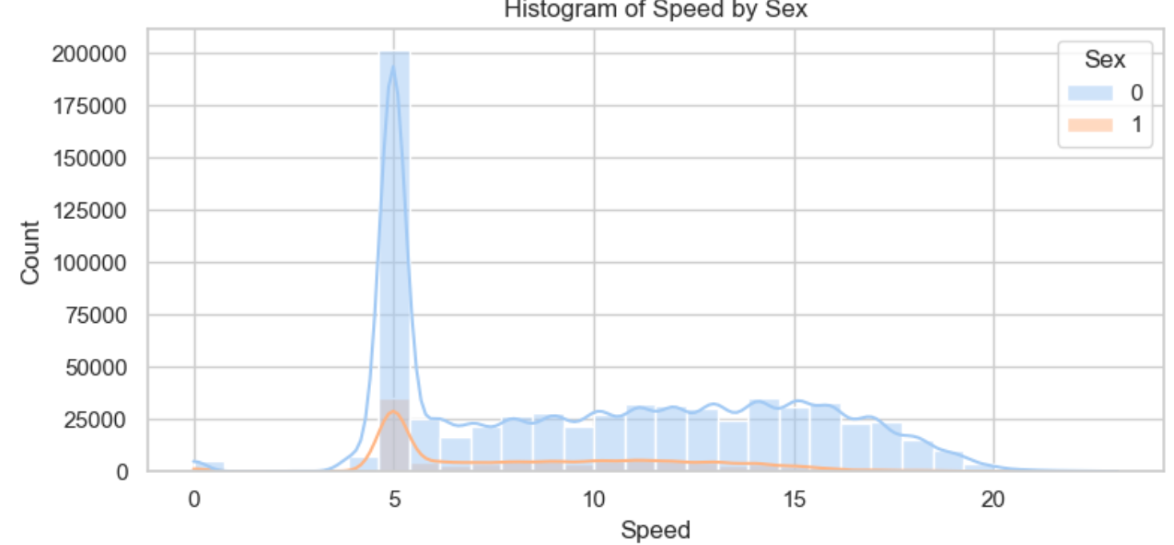
Expansion
From the above graph, it is clear that the value for the female is less for age and temperature in
comparison to the male

Slide 9
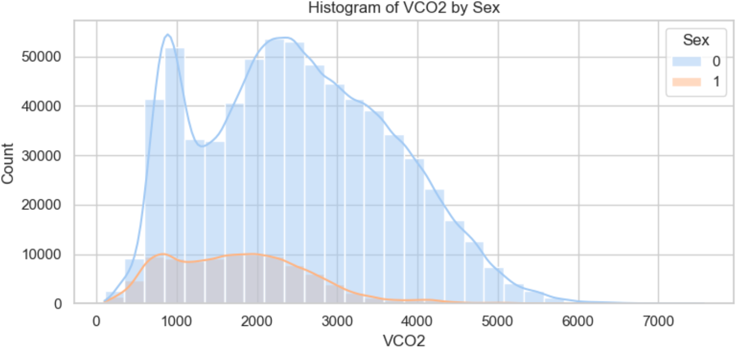
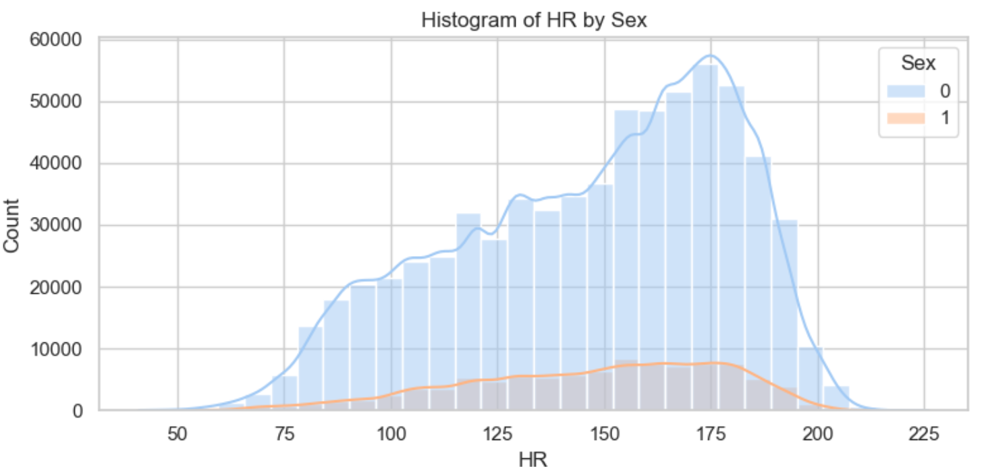
Expansion
From the above graph, it is clear that the value for the female is less for age and temperature in
comparison to the male

Slide 10
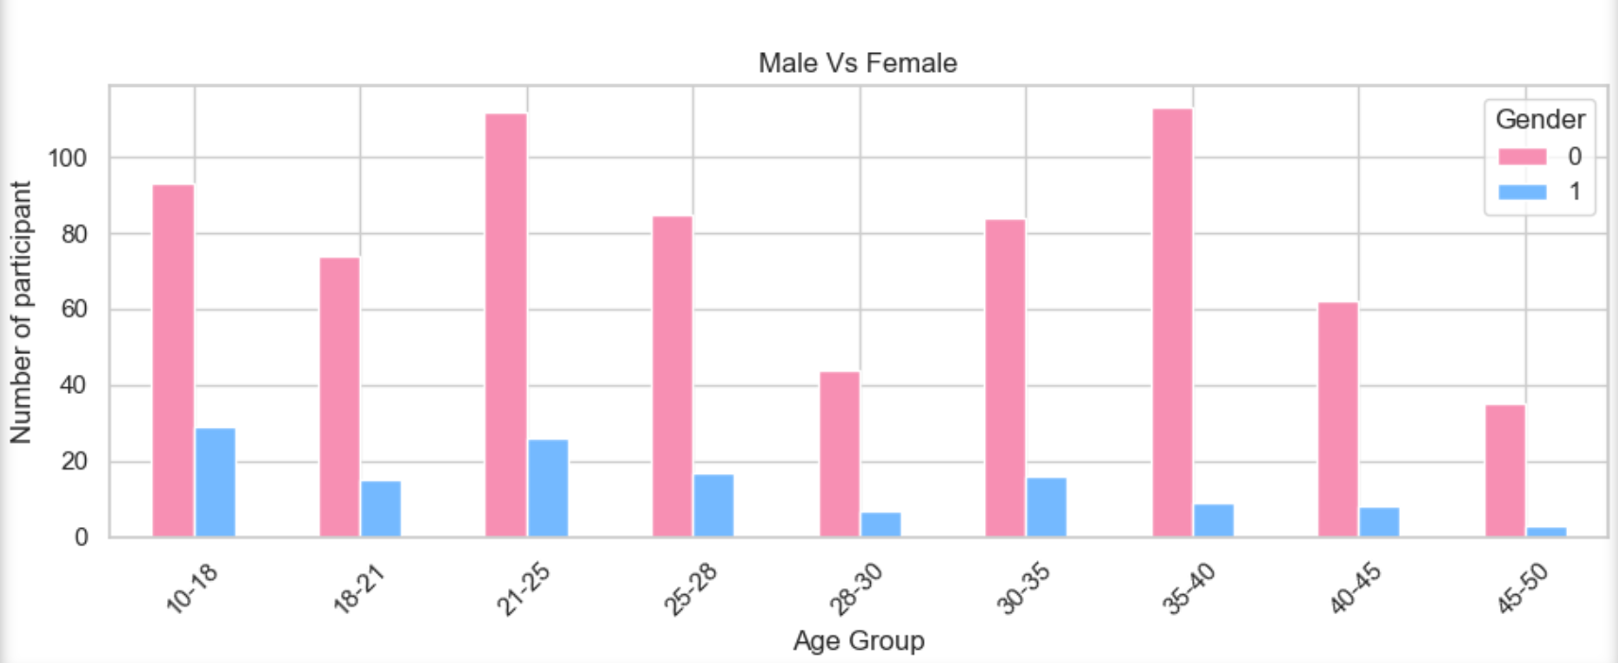
Expansion
Inference: Female count of the participants is always less in the training.
It should be noted that the count of the participants reduces with the age factors also. This Infers that there is clear and wide scope is available in the campaign section around female sector in ages above 25yrs.

Slide 11
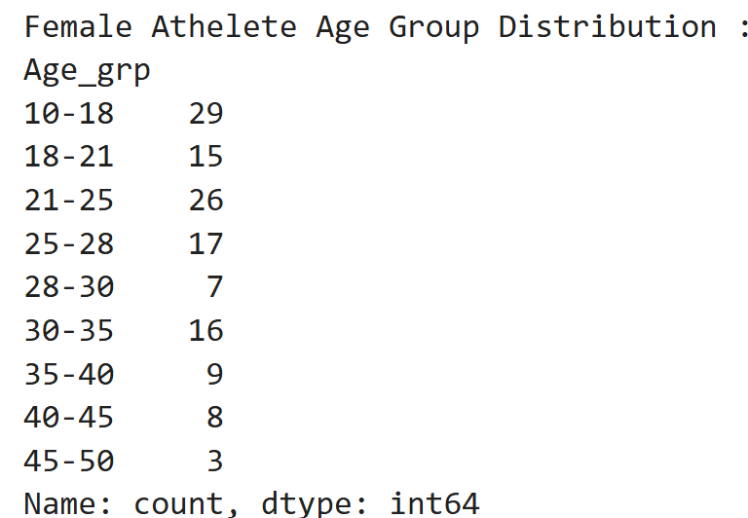
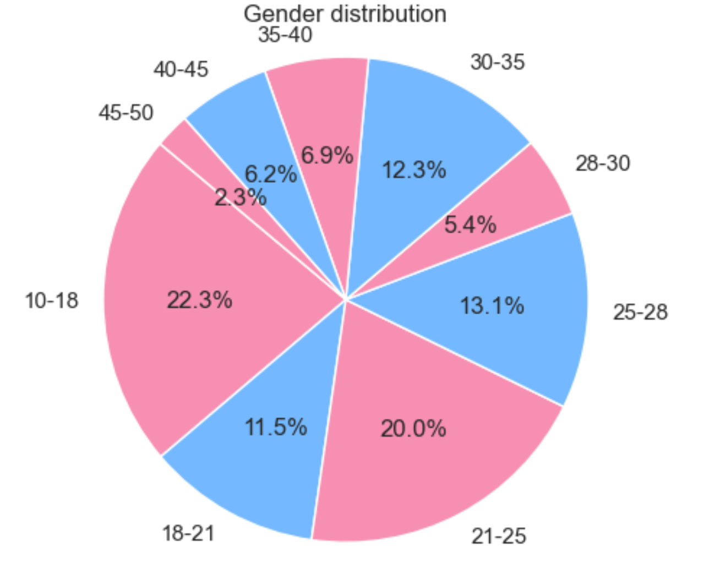
Expansion
Inference: Female participant above 25 yrs is less. There is a clear study shows the importance of the physical activities for women. https://www.nhs.uk/live-well/exercise/physical-activity-guidelines-for-adults-aged-19-to-64/#:~:text=Adults%20should%20aim%20to%3A,vigorous%20intensity%20activity%20a%20week

Slide 12
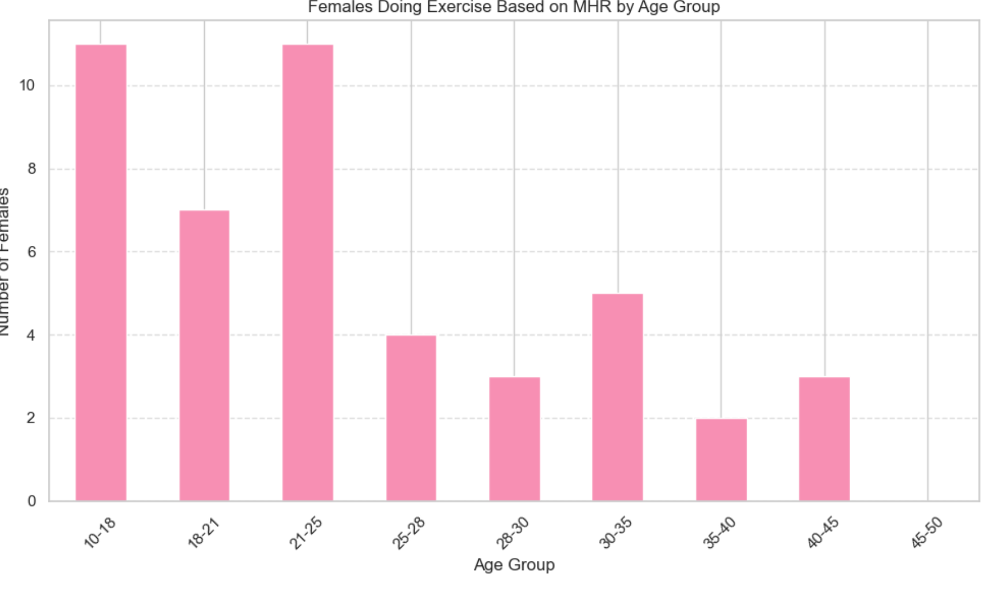
Expansion
This shows the intensity of the exercise also reduces with age. There is a clear picture of reduce in the count in late
twenties. But it also shows the Female are getting about their health at early forties. So not only the Gender but the
Target age group is also achieved

Slide 13
Expansion
Thank you

